Slide 2

Asian Paints Store
Presented by,
Vamshi Vushakola(082085)
Rohit John Alex(082093)

Slide 3
Objective
B2B implementation approach.
Launching the Asian Paints store.
To allow customers search, view and buy products.
To allow customers to buy variant products (color and style).
To allow users to authenticate before being able to browse the site.
It allows to view and manage customer orders, review and edit shipping information, search for and view your inventory information.
Reduce shipping time and shipping costs.
To allow customers to checkout using PayPal
To allow customers to schedule replenishment.

Slide 4
Use cases
Following use cases we have implemented.
Checking products by Browsing Site
Searching products through search
Adding Item in cart
Modifying quantity of items in cart
Clear Cart
Continue shopping (after adding items in cart)
Continue shopping (after placing orders)
Placing Order (Complete Check out process)
View Order History
Early Login
OMS ( Order Management Service)
It allows you to view and manage customer orders
Review and edit shipping information
Manage returns and refunds
Search for and view your inventory information.
BrainTree-PayPal
Checkout using PayPal

Slide 5

System Requirements
Software requirements:
Windows 7 OS (64 bit)
Latest Hybris zip(5.7.0.5)
Java (jdk 1.8) to be installed.
Need to set path(jdk1.8\bin) & class path.
Hardware requirements:
Processor: i5 or i7.
RAM : 8GB.

Slide 6
High Level System architecture
Asian Paints cockpits
Asian Paints hmc
Asian Paints webservices
Asian Paints others
Asian Paints business services
(Classification,Prices calculation,CMS..)
Asian Paints Models
Asian Paints infrastructure services
(Cache,Security,Transaction,Session)
Asian Paints Service Layer Framework
Asian Paints Persistence
Asian Paints Items
Database

Slide 7
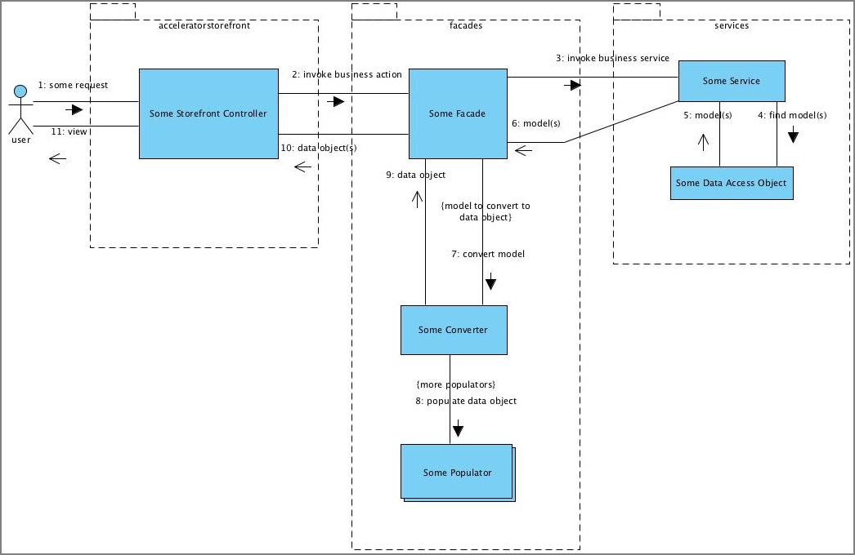
Sequence Diagram

Slide 8
Custom Store Setup

Slide 9
Implementation Approach
Overview
Download hybris Commerce Suite 5.7.0.5 from https://wiki.hybris.com/display/downloads/Download
Change to the hybris/installer directory
Setup Hybris 5.7 environment.
Extract zip file.
Run install.bat-r b2b_acc_plus from {HYBRIS_HOME}/installer directory
Run setantenv.bat

Slide 10
Cont..
To create a completely new storefront ( Asianpaints store )
Run ant modulegen from command prompt :
Please choose a template for generation
accelerator
Please choose the name of your module extension
asianpaints
Please choose the name of your module extension
com.asianpaints

Slide 11
Cont..
Now edit <<hybris-commerce-suite-5.7.0.5 HOME>>\installer\recipes\b2b_acc_plus\build.gradle
(replace yaccelerator by asianpaints) Like below:
Extensions
{
...
extName ' asianpaintscockpits'
extName ' asianpaintsinitialdata'
extName ' asianpaintsfulfilmentprocess'
extName ' asianpaintsstorefront'
extName ' asianpaintscore'
extName ' asianpaintsfacades'
extName ' asianpaintstest‘
….
}

Slide 12
Cont..
pl.project.addons
{
...
template “asianpaintsstorefront"
storeFronts “asianpaintsstorefront"
...
}
Navigate to the {HYBRIS_HOME}/installer directory
And Run install.bat -r b2b_acc_plus

Slide 13
Cont..
After this step you should have 7 custom extensions in custom folder, that have been adopted to your project's namespace.
/custom/asianpaints /asianpaintscockpits
/custom/asianpaints /asianpaintscore
/custom/asianpaints /asianpaintsfacades
/custom/asianpaints /asianpaintsfulfilmentprocess
/custom/asianpaints /asianpaintsinitialdata
/custom/asianpaints /asianpaintsstorefront
Initialize system using the below step
Navigate to the {HYBRIS_HOME}/installer directory and Run install.bat -r b2b_acc_plus initialize

Slide 14
Cont..
Now Start Hybris Server platform: hybrisserver.bat
Check the default electronics store by: https://localhost:9002/asianpaintsstorefront/?site=powertools
Setup new eclipse workspace and import bin and config folder into it.
We can define a custom webroot for the store:
Modify this in/asianpaintsstorefront/extensioninfo.xml.
<webmodule jspcompile="false" webroot="/asianpaintsstorefront"/>

Slide 15
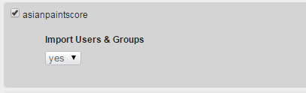
Cont..
In addition, we have to adjust local.properties to override properties defined in asianpaintsstorefront.
/config/local.properties
asianpaints storefront.webroot=/store storefrontContextRoot=/store website.asianpaints .http=http://asianpaints .local:9001/asianpaintsstorefront website.asianpaints .https=https://asianpaints . local:9002/asianpaintsstorefront
Now rebuild the code base (ant clean all) and restart the hybris server.
Navigate to http://localhost:9001 then Platform

Slide 16
Cont..
After this modify java class InitialDataSystemSetup.
Next is Impex Basic Store data
In this we will provide impex files for the basic Asian Paints store data.(like store.impex,site.impex,solr.impex,etc)
The data is imported by CoreSystemSetup using an initialization hook.

Slide 17
Cont..
Impex files for import Asianpaints Basic Store data:
File name | Description
Store.impex | This file contains store related information.
Store-en.impex | This file adds English localized attribute values for the basic store items.
Site.impex | This file adds basic site information to the configuration of the Asian Paints shop - again you need to substitute several macros in the same way as in above store.impex file.
Site_en.impex | Provide English-language localization for the hybris CMSSite.
Solr.impex | Update the basic solr configuration, including information for ranges, facets, index names, etc.
Solr_en.impex | Update the Solr localization.
solrtrigger.impex | For Solr indexing triggers.

Slide 18
Cont..
Asian Paints Content Catalog Data:
File name | Description
catalog.impex | The Asian Paints Content Catalog.
catalog_en.impex | Here edit the related localization.
cms-content.impex | Now the Master CMS content, which defines all of the content slots for the templates, naming the templates.It does not rely on any specific product/category content.
cms-content_en.impex | The related localized attributes values - again check the file content and replace the __CONTENT_CATALOG_NAME__ with asianpaintsContentCatalog.
email-content.impex | Update the email notification layouts.
email-content_en.impex | Populate the email localized content.

Slide 19
Cont..
Asian Paints Product catalog data:
File name | Description
catalog.impex | Update the product catalog impex file.
catalog_en.impex | Do the same as above for the localized catalog data.
Mobile Files:-
File name | Description
cms-mobile-content.impex | The mobile imports are not referenced further in the trail and may be removed.
cms-mobile-content_en.impex | The English localization.

Slide 20
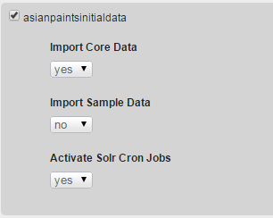
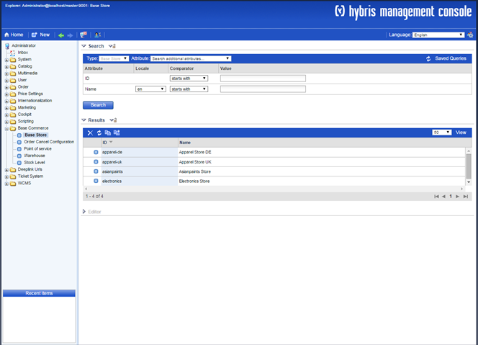
Cont..
Run the project data initialization for the asianpaints core extension
Run ant all.
Update the project data of the asianpaints core extension:
Once you have imported the data, you can go to the hmc and look in the Base Commerce section that we have a new store called ‘asianpaints ‘.

Slide 21
Cont..
Create Products:
In this we will provide impex files for the basic Asianpaints store data.
(like ,categories,products,products-media,product-stocklevel,etc.)
After this run ant all and restart hybris server update asianpaintsinitialdata—import sampledata(yes).
Import product categories:-
File name | Description
categories.impex | Imports Categories for your products.
categories_en.impex | Imports localized names for categories.
Import suppliers:-
File name | Description
suppliers.impex | Imports store's suppliers.

Slide 22
Cont..
Import Products:-
File name | Description
products.impex | Imports products available from the merchandise store.
products-media.impex | Import product medias.
products_en.impex | Imports localized attributes of the products.
Import product prices:-
File name | Description
products-prices.impex | Imports prices of the products.
Import product relation data (cross-selling, accessories):-
File name | Description
products-relations.impex | Imports relations between the products.

Slide 23
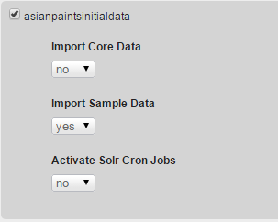
Cont..
Import stock levels:-
File name | Description
products-stocklevels.impex | Imports warehouse stocklevels for the products.
Assign warehouse to base store:-
File name | Description
warehouses.impex | Navigate to the sampledata/stores/asianpaints directory, and assign a warehouse to the base store.
Restart the server & Go to the admin console:

Slide 24
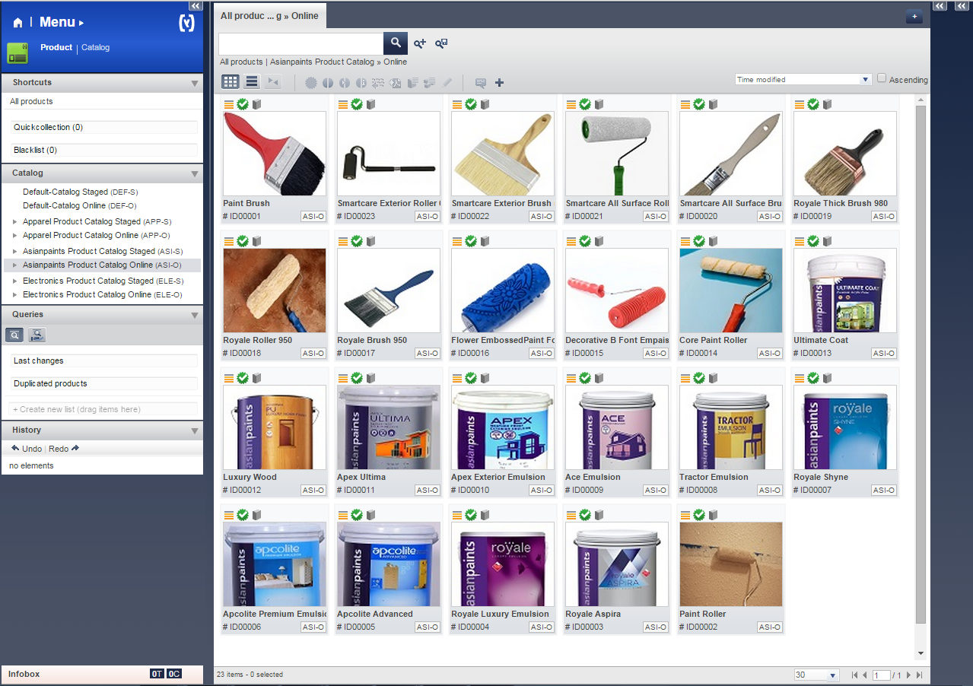
Cont..
go and visit productcockpit to review newly created products

Slide 25
Cont..
Import site content
Remember that the following files are relative to the asianpaintsinitialdata/resources/asianpaintsinitialdata directory.
Import CMS data:-
File name | Description
cms-content.impex | Real CMS content for the Asian Paints site.
cms-content_en.impex | Localized CMS content.
Import email content:-
File name | Description
email-content.impex | Here add email content.
email-content_en.impex | Localized email content for English.
Configuring cmsmanager:-
File name | Description
cmscockpit-users.impex | Here configure cmsmanager.

Slide 26
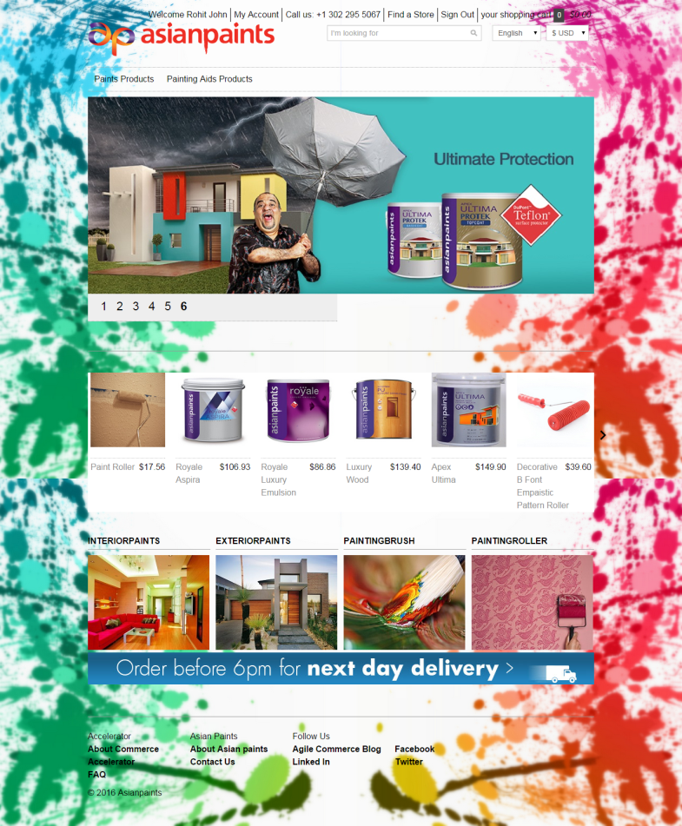
Links
Asian Paints Store Link: https://asianpaints.local:9002/asianpaintsstorefront/asianpaints/en/

Slide 27
Early Login

Slide 28
Early Login
Authentication
Users required to authenticate before being able to browse the site.
For this we require secureportaladdon AddOn to install which is included in the b2b_acc_plus installation recipe.
When the AddOn is installed, the features of the secureportaladdon AddOn are enabled automatically.

Slide 29
Implementation Approach
Installing the B2B Early Login AddOn
B2B Early Login AddOn is installed using ant addoninstall.
Check whether this secureportaladdon is listen in config/localextensions.xml file
Run the following ant task
ant addoninstall -Daddonnames="secureportaladdon" -DaddonStorefront.asianpaintsb2bstorefront="asianpaintsb2bstorefront“
Run ant all.
Rebuild the system.
/config/localextensions.xml
... <extension name="secureportaladdon" /> ...
29

Slide 30
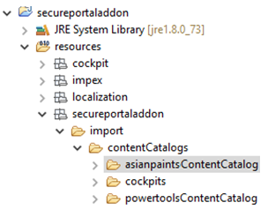
Cont..
Now In the hybris Administration Console (localhost:9001):
Update the system (Platform > Update), use the following options:
Select the options Update running system, Create essential data, and Localize types.
In the project data settings, select the secureportaladdon check box, and set Sync Content Catalogs to yes.
Click Update.
Now import secureportaladdon to workspace and navigate to secureportaladdon/resources/secureportaladdon/import
Copy powertoolsContentCatalog folder and rename it as our own custom content catalog (asianpaintsContentCatalog) and paste in that folder only like below.

Slide 31
Impexes
Asian Paints Content Catalog Data:
File name | Description
cms-content.impex (/secureportaladdon/resources/secureportaladdon/import/contentCatalogs/asianpaintsb2bContentCatalog/cms-content.impex) | Now the Master CMS content, which defines all of the content slots for the templates, naming the templates. It does not rely on any specific product/category content.
cms-content_en.impex (/secureportaladdon/resources/secureportaladdon/import/contentCatalogs/asianpaintsb2bContentCatalog/cms-content_en.impex) | The related localized attributes values - again check the file content and replace the __CONTENT_CATALOG_NAME__ with asianpaintsContentCatalog.
31

Slide 32
Cont..
After making changes in impexes
Go to hAC/Console/ImpEx Import and import both cms-content.impex and cms-content_en.impex files.
/secureportaladdon/project.properties
Provides factory default settings. It is not recommended to edit this file. But we have to take the reference of this file to override in local.properties
/config/local.properties
This is the working copy of the project.properties file that will be found in the config folder. Use this file to override the default hybris settings

Slide 33
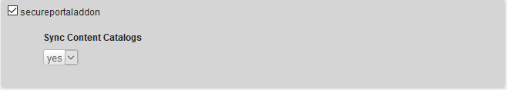
Update
Now restart hybris server
Go to hAC >> platform >> update >> secureportaladdon

Slide 34
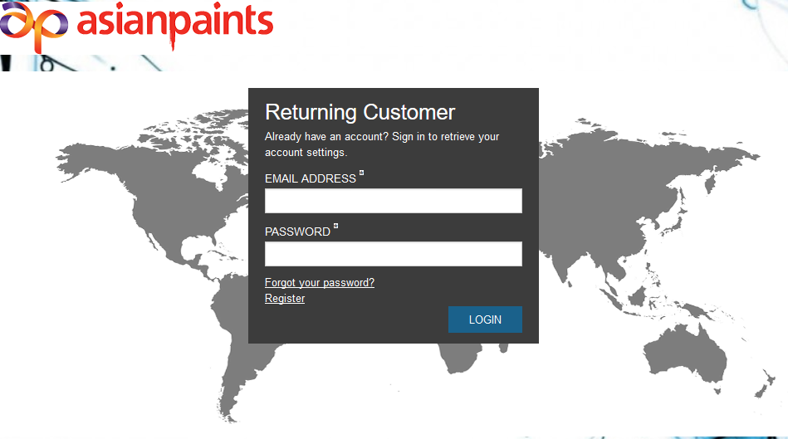
Early Login Page
As shown in the picture below, when the B2B Early Login AddOn is enabled, the early login page displays like below, there is no header or footer, or any links that could expose the rest of the site.

Slide 35
Order Management Service(OMS)

Slide 36
OMS(Order Management Service)
It allows you to view and manage customer orders, review and edit shipping information, manage returns and refunds.
Basically Order Management Services out of the box works for B2C scenarios. In order to enable Order Management Services with a B2B scenario, a little customization is required.
Key Benefits of OMS
Fulfil from anywhere
A centralized view of inventory
Reduce shipping time and shipping costs

Slide 37
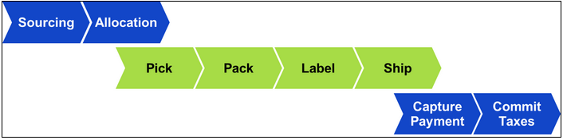
Order Management Services Workflow
When an order is received from the hybris Accelerator, OMS processes and completes the order by performing the steps as shown in the following figure.
Sourcing
Sourcing is the action of determining which physical location (or locations) will supply all items for an order.
Allocation
Allocation is the action of grouping order items into consignments (that is, determining which items of an order will be shipped from a single location in a single box or package).

Slide 38
Cont..
Pick, Pack, Label, and Ship
Once an order is allocated, the following steps in the order workflow take place:
A pick list is printed, which lists the item(s) that need to be collected from the store or warehouse shelf.
A pack slip is printed, which indicates all the items that need to be packed in a single shipping box or package.
A label is printed, which displays the customer's shipping address. Details vary depending on the shipping carrier.
The order is shipped and confirmation of the shipment is logged in OMS.
Payment Capture
After the order is packed and ready to be shipped, the payment is charged to the customer. OMS communicates with a third-party payment service provider to complete the payment capture.
Commit Taxes
The final step of the workflow is to determine the tax amount of an order and to log the information, so that a tax invoice can be created. OMS communicates with a third-party tax invoicing service to complete the tax invoicing.

Slide 39
Implementation Approach
From your root hybris installation folder:
Go to installer/recipes
Create a folder called "b2b_acc_oms"
Within this new folder, create a new file named "build.gradle" and add the content into it.
Setup
To setup the hybris platform with the OMS extensions, run the following command:
Windows: install.bat -r b2b_acc_oms setup
Unix: ./install.sh -r b2b_acc_oms setup
Initialize
To initialize the platform, run the following command:
Windows: install.bat -r b2b_acc_oms initialize
Unix: ./install.sh -r b2b_acc_oms initialize
Start
To start the platform, run the following command:
Windows: install.bat -r b2c_acc_oms start
Unix: ./install.sh -r b2c_acc_oms start

Slide 40
You need to have an extension generated from yacceleratorordermanagement.
Use command: ant extgen on hybris/bin/platform folder and choose the option to create an extension out of the yacceleratorordermanagement template and follow the instructions.
During the generation process you will be asked to choose an extension name please make sure to name it: omsb2b
When asked for the package name input de.hybris.platform.omsb2b
If you choose different naming, you are responsible to modify the code to correspond to your package and naming.
For this example, we named the newly generated extension omsb2b but you can name it according to your needs.
In this generated extension (omsb2b), you need to add a required extension into the extensioninfo.xml.
extensioninfo.xml
... <requires-extension name="b2bapprovalprocess"/> ...

Slide 41
After successfully generating your new extension you have to go back to your localextensions.xml and replace the yacceleratorordermanagement extension by the newly created omsb2b extension as follows:
Go to /hybris/bin/platform home and build your system by calling ant clean all.
localextensions.xml
<!--B2B list of extensions --> <extension name='b2bacceleratoraddon' /> <extension name='b2bacceleratorservices' /> <extension name='b2bapprovalprocess' /> <extension name='b2bcommerce' /> <extension name='b2badmincockpit' /> <extension name='b2bcommercebackoffice' /> <!--ordermanagement list of extensions --> <extension dir="{$commerceSuiteHome}/hybris/bin/custom/omsb2b"/> <extension name='warehousingbackoffice' /> <extension name='warehousing' /> <extension name='ordermanagementbackoffice' />

Slide 42
Modification of the ApprovalProcessCompleteAction
In B2B, the placement of an order goes through an approval process. You could have several ways to approve an order but each one of them is ending with an ApprovalProcessCompleteAction.
The customization goal is to overwrite this final step so that it will:
Publish an event of type ApprovalProcessCompleteEvent (insurance for backward compatibility).
Create/Start the order process engine defined in the OMS extension.
you need to create a java class for approval process
Now you have to add a b2bapprovalprocessserver.jar to your build path because IDE might not know where to find ApprovalProcessCompleteEvent.
You can find jar in, commerceSuiteHome/hybris/bin/ext-commerce/b2bapprovalprocess/bin.
extensioninfo.xml
... <requires-extension name="b2bapprovalprocess"/> ...

Slide 43
Cont..
Then, you must declare this new bean into your spring context:
This overwrites the default behavior of the approval process complete action and the orders placed from B2B will be managed by the order process engine.
After you make the changes above, you can go to your platform home and build by calling ant clean all.
Your build should be successful, initialize and run the hybris server then test that an order made from the asianpaints website will have consignments in backoffice.
omsb2b-spring.xml
... <alias name="defaultApprovalProcessCompleteAction" alias="approvalProcessCompleteAction"/> <bean id="defaultApprovalProcessCompleteAction" class="de.hybris.platform.omsb2b.actions.b2b.OmsApprovalProcessCompleteAction" parent="abstractAction"> <property name="businessProcessService" ref="businessProcessService"/> <property name="eventService" ref="eventService"/> </bean> ...

Slide 44
Test the OMS Installation
Go to https://localhost:9002/asianpaintsb2bstorefront/ place an order for an item eg. Apcolite 10L and Follow instruction to continue your checkout.
To test if OMS has received the order you placed, just point your browser to: http://localhost:9001/backoffice/,
Then click on the Order Fulfillment icon at the top of the window. Then go to "Order Shipping" and click on "All Consignments".

Slide 45
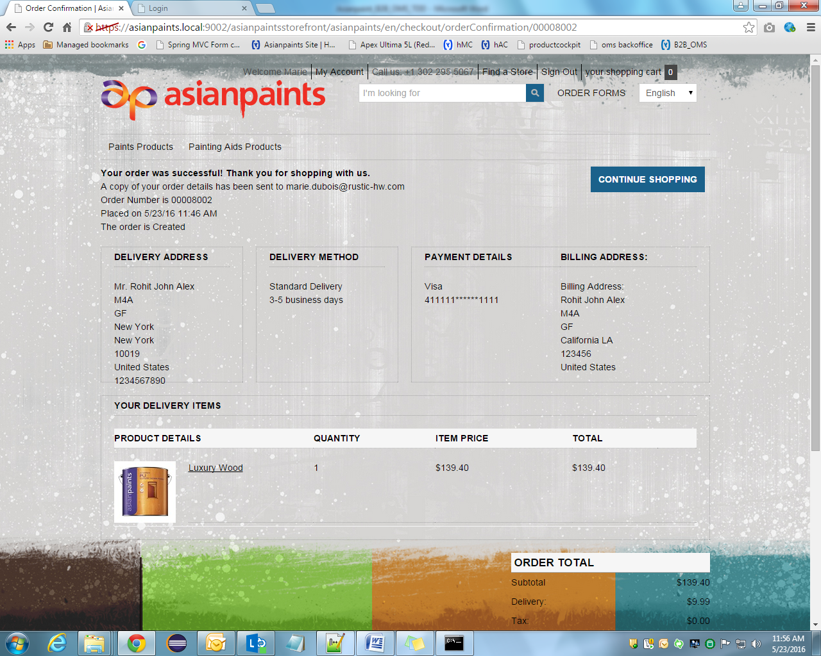

Slide 46
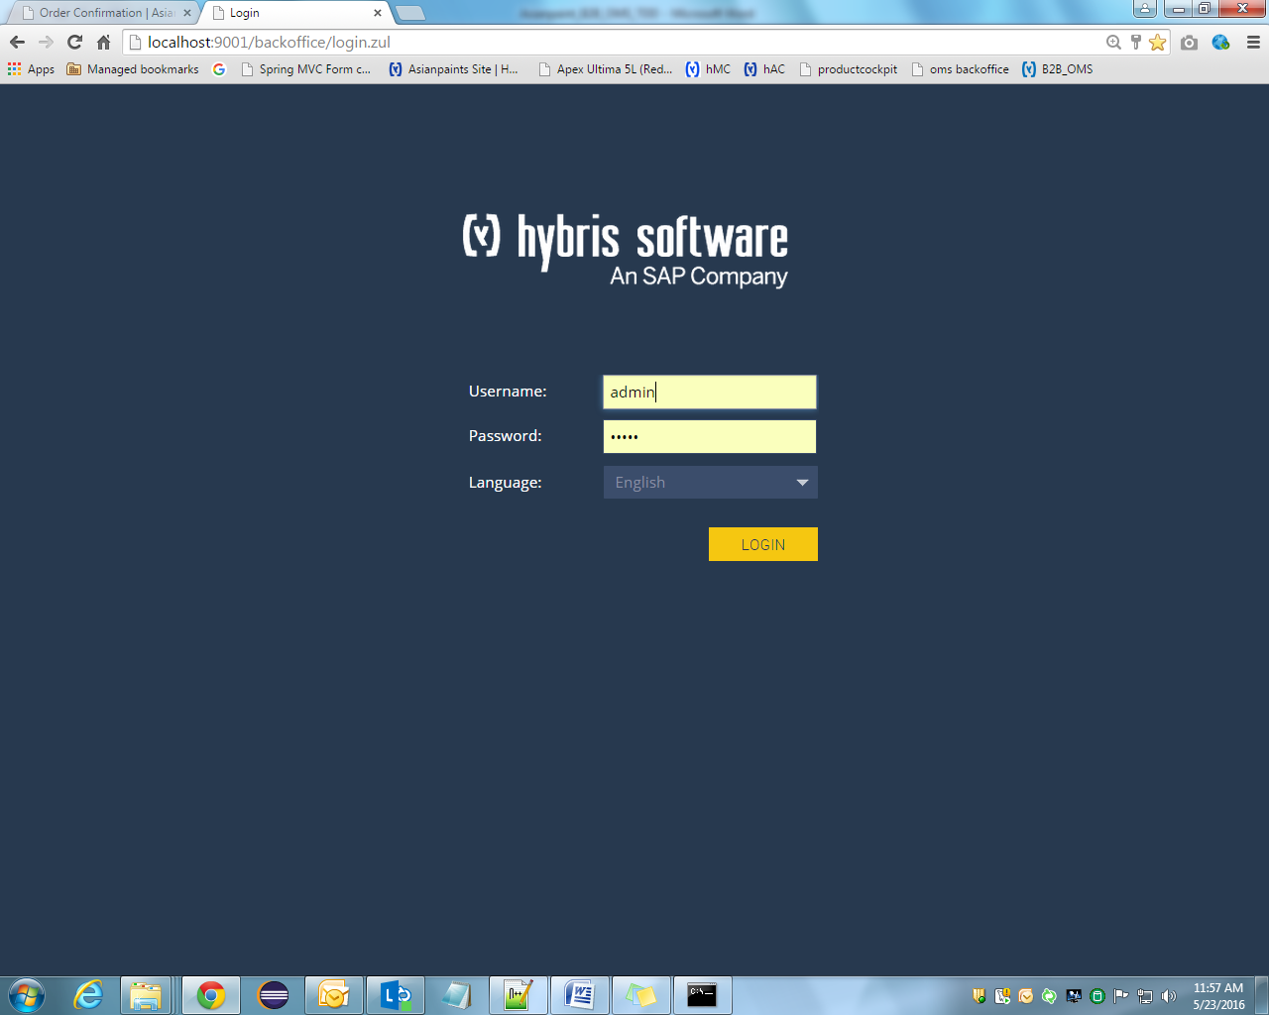

Slide 47
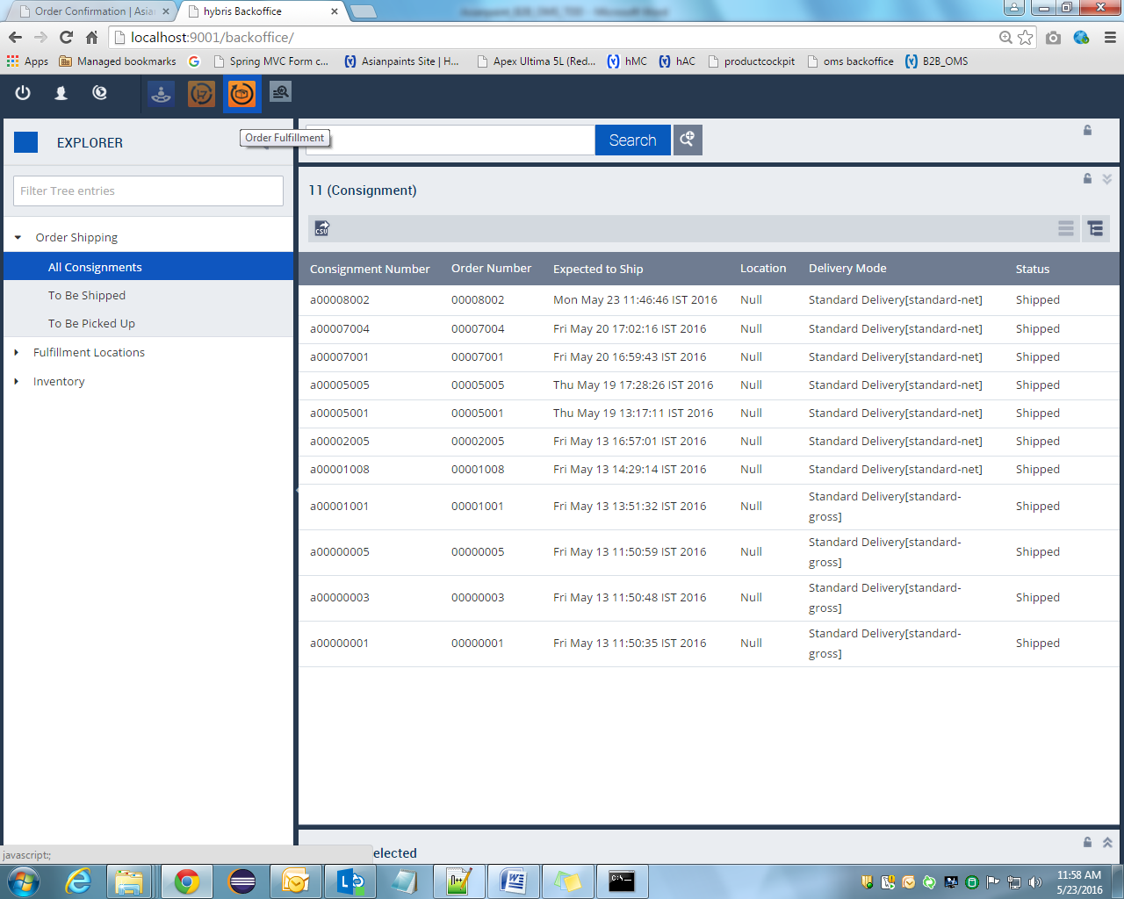

Slide 48
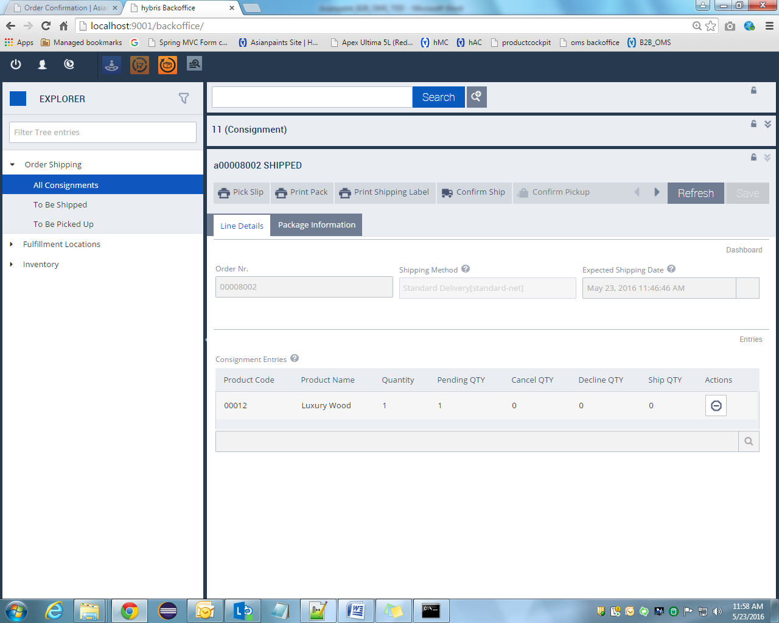

Slide 49
BrainTree-PayPal
Braintree hybris Add-on extends default hybris Commerce Accelerator Multistep Checkout Flow therefore it can be installed only on hybris Commerce Accelerator storefront.
The add-on main goal is to integrate complete Braintree v.zero flow including the most up-to-date features with the latest versions of hybris Commerce Suite (5.2-5.7).
In case applying this plugin to non-accelerator storefront only BrainTree (contained hybris BrainTree payment adapter) and braintreecscockpit extensions can be used.
Appropriate add-on extension (braintreeaddon/braintreeb2baddon/braintreeb2ccheckoutaddon) should be replaced with custom extension implemented for integration hybris Braintree payment adapter with custom merchant storefront using given Braintree hybris Add-on as example.

Slide 50
Architectural Overview
GOALS
The main goal for Braintree-hybris integration is end-to-end solution.
This end-to-end solution is used by merchants and developers with the most recent hybris platforms.
This solution should be easy to plug in, configure, and extend for particular business needs.
General Braintree v.zero payment flow
General Braintree v.zero payment flow was used in the integration and it is depicted on the diagram

Slide 51
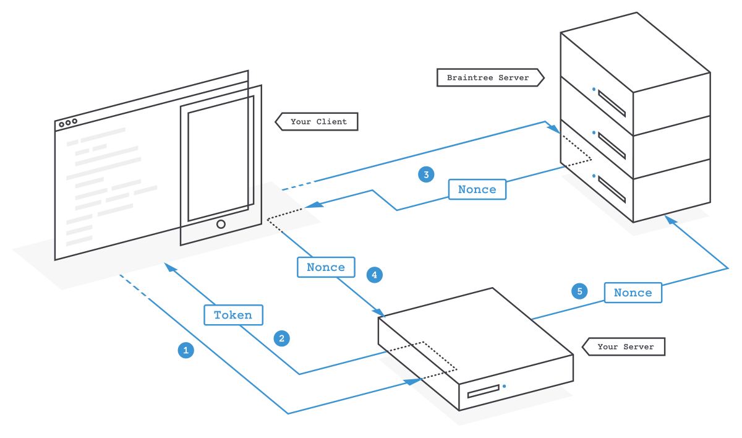
Braintree v.zero Checkout flow

Slide 52
Plugin Checkout flow consists of next steps:
Braintree payment adapter generates client token using Braintree Java server SDK and sends this token to UI view for initializing Braintree JavaScript client SDK.
Braintree JavaScript SDK collects customer payment information and sends payment information – like a credit card or a PayPal authorization – to Braintree server in exchange for a payment method nonce (representing customer payment authorization).
BrainTreePaymentController (or PayPalPaymentController in case PayPal authorization via Braintree) receives payment method nonce along with payment details from UI and sends it to Braintree payment adapter.
Braintree payment adapter creates a transaction using a payment method nonce and payment details through Braintree Java API.

Slide 53
The solution consists of 3 extensions:
braintree - extension contains business logic to communicate with Braintree server through the Braintree API.
braintreecscockpit - extension that extends hybris Customer Service Cockpit with Braintree specific functionality.
braintreeb2baddon - extensions that were built on hybris AddOn concept which was introduced in 5.0 hybris version. This allowed us to add functionality to B2B Accelerator without touching the core code base. That approach is in accordance with hybris best practice recommendations when logic and storefront- related features are in separate extensions, braintreb2baddon is installed for hybris B2B Accelerator 5.7.

Slide 54
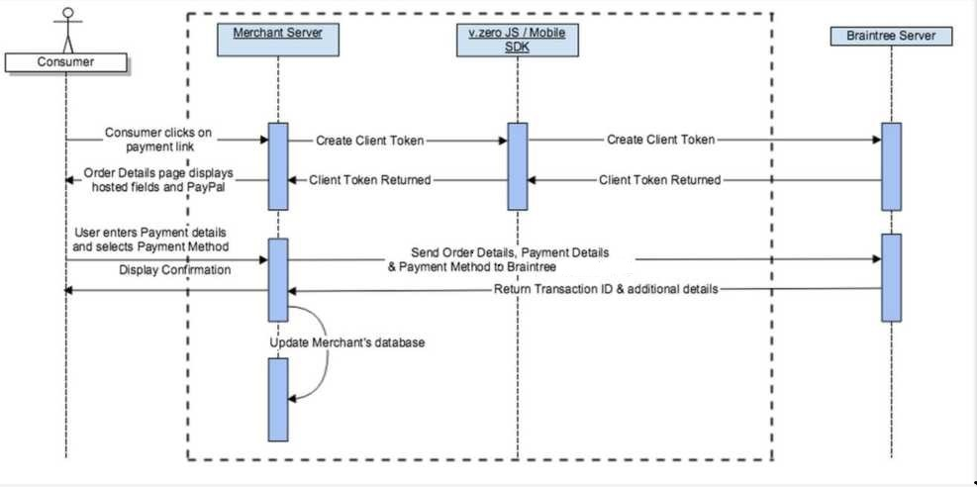
Process View

Slide 55
Cont..
Interaction diagram demonstrates the add-on layering approach
Once a merchant generates a Client Token, the merchant invokes the Braintree JavaScript SDK to display the 'Hosted Fields' (credit card number, expiration date, and cvv2) and/or PayPal shortcut button (PayPal integration via Braintree).
After the customer enters their card details, the Braintree JavaScript SDK captures the card number, expiration date, and cvv2 details and upon the form being submitted, receives a payment method nonce from Braintree server.
In case of PayPal integration via Braintree - PayPal checkout flow is initiated, and in case successful customer authorization payment method nonce is returned from Braintree server.
Payment method nonce along with payment details is sent from UI to merchant server.
Braintree payment adapter creates a transaction using a payment method nonce and payment details through Braintree Java API.

Slide 56
Security
In order to work with Braintree payment gateway, valid credentials including public and private keys need to be obtained and used:
braintree.merchant_id=vbjt6q2zp8nq4vgh
braintree.public_key=7zyy96mftydc47sp
braintree.private_key=2a48f4b9a1ca941a4eec76eaca037d8e
Note: This is just an example of credentials; don’t try to use them for any purposes. You have to register on Braintree Sandbox to get those credentials.

Slide 57
PayPal Express checkout
One-time payment checkout.
It offers a streamlined (velocity is constant/varies at regular interval) checkout flow that keeps customers local to your website throughout the payment authorization process.
Checkout with PayPal supports the following features:
Select or add shipping addresses in the PayPal account
Select or add funding instruments in the PayPal account
PayPal One Touch for web
Two factor authentication support (currently only for US, UK, CA, DE, AT, and AU)
Typical use cases for the Checkout With PayPal flow:
Checkout from Cart/Product pages
Checkout page replacement

Slide 58
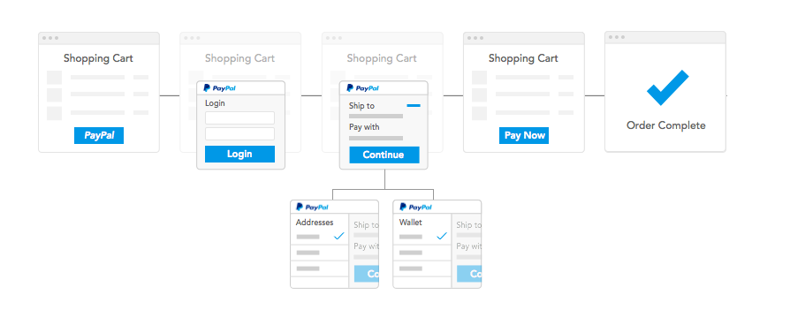
Cont..
For Express Checkout with PayPal Address page is skipped (shortcut) in order to speed up the checkout time.
Shipping and billing addresses are returned from PayPal account.

Slide 59
Configuration with PayPal
For development and testing purposes you firstly need to register PayPal Sandbox business account at https://www.developer.paypal.com/
You will also need a personal PayPal Sandbox account to make test payments from it.
Installing Add-on
For Hybris B2B versions 5.7 – b2bacceleratoraddon extension must be installed if it has not yet installed.
Update localextensions.xml:
Add <extension name=" b2bacceleratoraddon "/>
Run installation command
Stop Hybris if it’s running with Ctrl+C
Run ..\bin\platform\setantenv.bat if it was not applied in this terminal
Go to ..\bin\platform and run installation command:
ant addoninstall –Daddonnames = b2bacceleratoraddon - DaddonStorefront.asianpaintsb2bstorefront=”asianpaintsb2b”

Slide 60
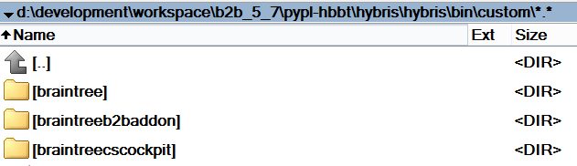
Downloading Add-on
Download adapter archive from the hybris marketplace.
Unpack archive and place folders braintree, braintreeb2baddon and braintreecscockpit into ..\bin\custom
Figure Add-on repository location for Hybris B2B 5.7

Slide 61
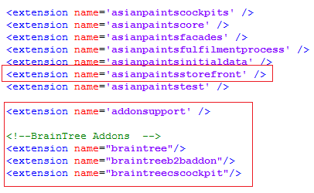
Update localextensions.xml
Check the presence of <extension name="addonsupport" />
Add following extensions
<extension name="braintree"/>
<extension name="braintreeb2baddon"/>
<extension name="braintreecscockpit"/>
Check the presence of target storefront extension

Slide 62
Run installation command
1. Stop hybris if it’s running with Ctrl+C
2. Run setantenv.bat if it was not applied in this terminal
3. Go to ..\bin\platform and run installation command:
ant addoninstall -Daddonnames=paypaladdon - DaddonStorefront.asianpaintsstorefront=asianpaintsstorefront

Slide 63
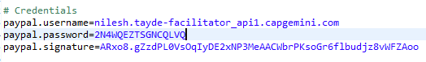
Main configurations
1. Go to ..\bin\custom\paypal\project.properties
2. Find and update the following configurations: paypal.username, paypal.password, paypal.signature and paypal.seller.email with your API credentials from PayPal business account.
Example of configured project.properties

Slide 64
Rebuild the system
Update
1. Go to hAC->Platform->Update
2. Choose 4 update options Update running system, Clear the hMC configuration from the database, Create essential data, Localize types
3. Choose add-on components to update: paypal, paypaladdon, paypalcscockpit
4. Then make update
5. After update finishes go to Console->Impex Import.

Slide 65
You can find ready scripts in add-on files:
..\bin\custom\paypaladdon\resources\paypaladdon\import\contentCatalogs\
For example, during testing we used cms-content and cms-mobile-content from
powertoolsContentCatalog.

Slide 66
6. Import content
7. Go to hMC->Catalog->Catalog Management Tools->Synchronization
8. Choose Source Catalog Version and execute Synchronization

Slide 67
PayPal Express checkout
Add-on offers PayPal Express Checkout (via Braintree) to merchants through the use of the “Check Out with PayPal” shortcut button. The solution is implemented into out-of-the-box B2B (for 5.7 version) hybris accelerators (both cart and mini-cart are affected).

Slide 68
Express Checkout with PayPal provides the ability to either do single use payments where the customer checkouts each time (PayPal checkout via Braintree); or multiple uses where the customer need only checkout the first time and any future payments are processed out of the Vault (PayPal Vault via Braintree).
Anonymous user (who hasn’t hybris account) has possibility to pay with PayPal Express Checkout without registering in Hybris accelerator.
Assuming that buyer has a PayPal account, he/she can initiate the Express Checkout flow on the shopping cart page or in-mini cart by clicking the Checkout with PayPal button.
For Express Checkout with PayPal Address page is skipped (shortcut) in order to speed up the checkout time. Shipping and billing addresses are returned from PayPal account.

Slide 69
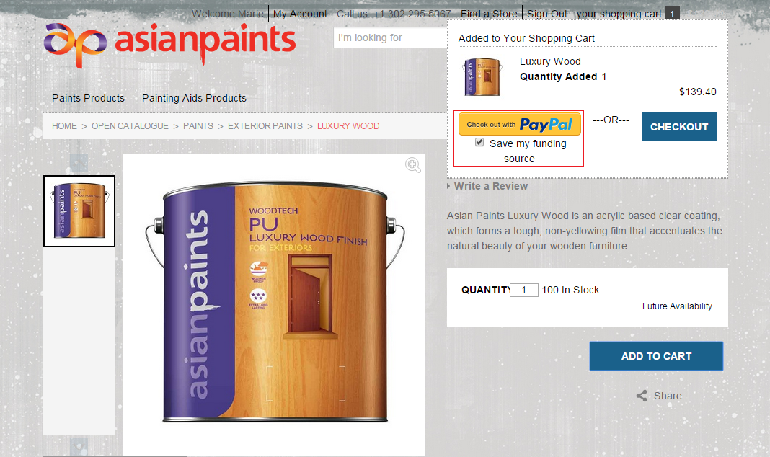
PayPal Express Checkout in Mini Cart

Slide 70
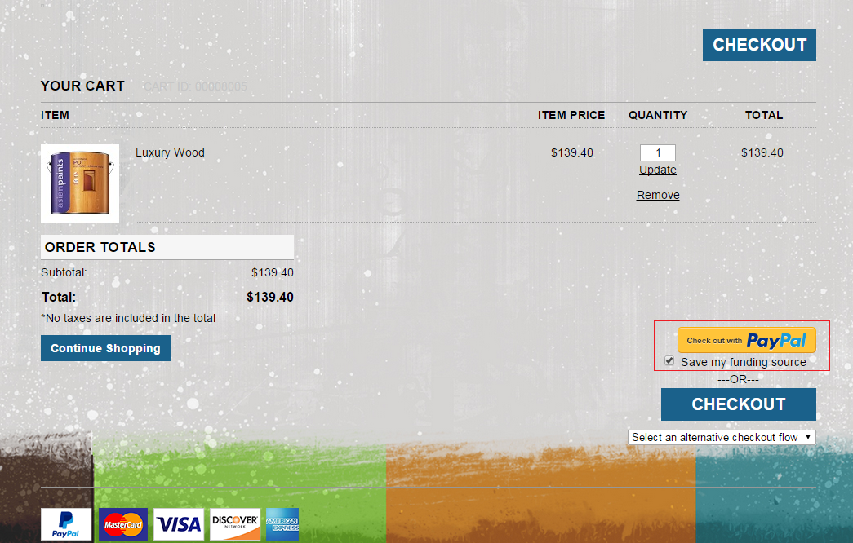
PayPal Express Checkout in Shopping Cart

Slide 71
The PayPal Express Checkout Shortcut will appear on the Shopping Cart page of hybris box B2B (for 5.7 version) accelerator and also in mini-cart.
Customer can choice between PayPal Vault and Checkout flows by checking or unchecking “Save my funding source” checkbox. The Vault flow (when “Save my funding source” checkbox is checked) will save the payment method for later reference, and Checkout flow (when “Save my funding source” checkbox is unchecked) is for one-time payments when you do not want to save the payment method
If a customer clicks on PayPal Express Checkout Shortcut, the PayPal Checkout Login popup is rendered

Slide 72
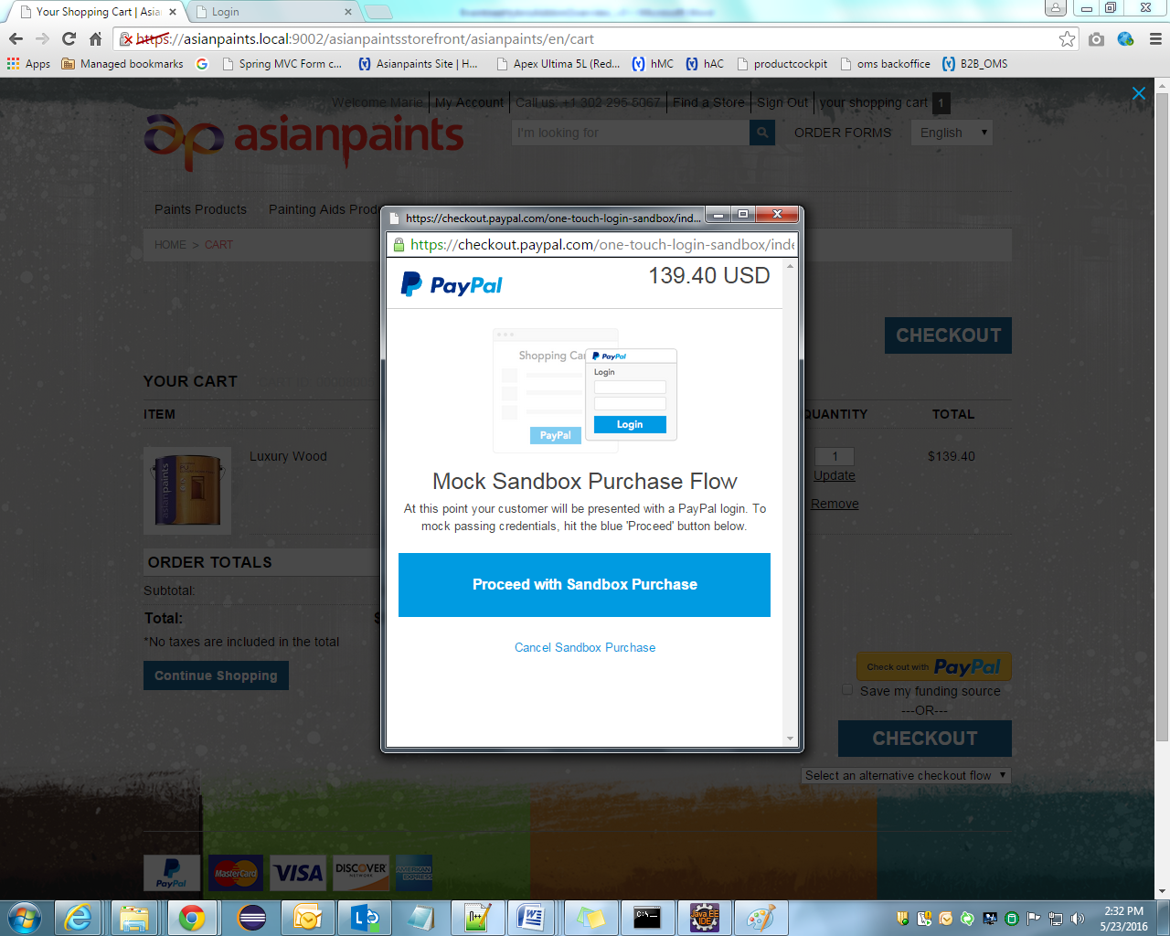
PayPal Checkout Login Popup
After success PayPal authorization customer will be redirected back to the hybris B2B accelerator review page

Slide 73
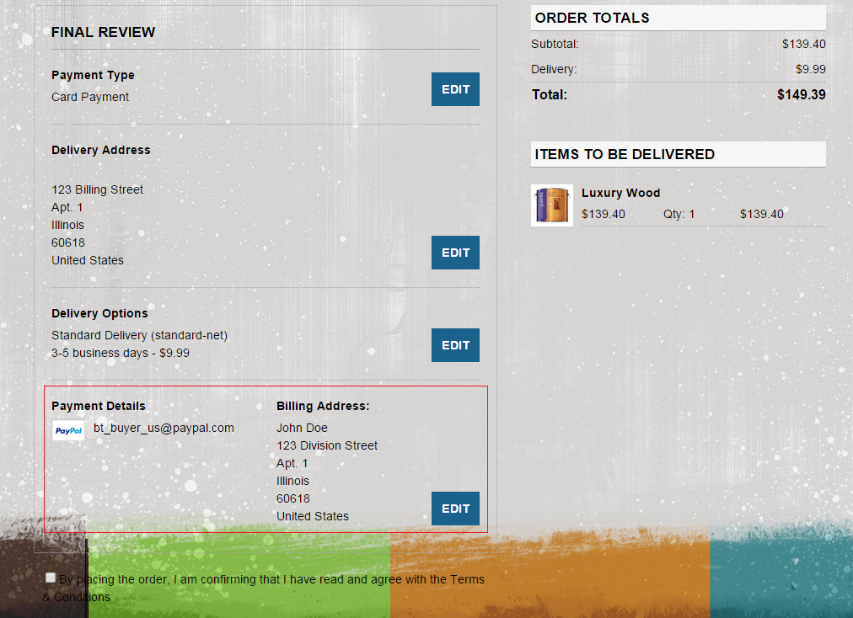
Final Review page on PayPal Express Checkout

Slide 74
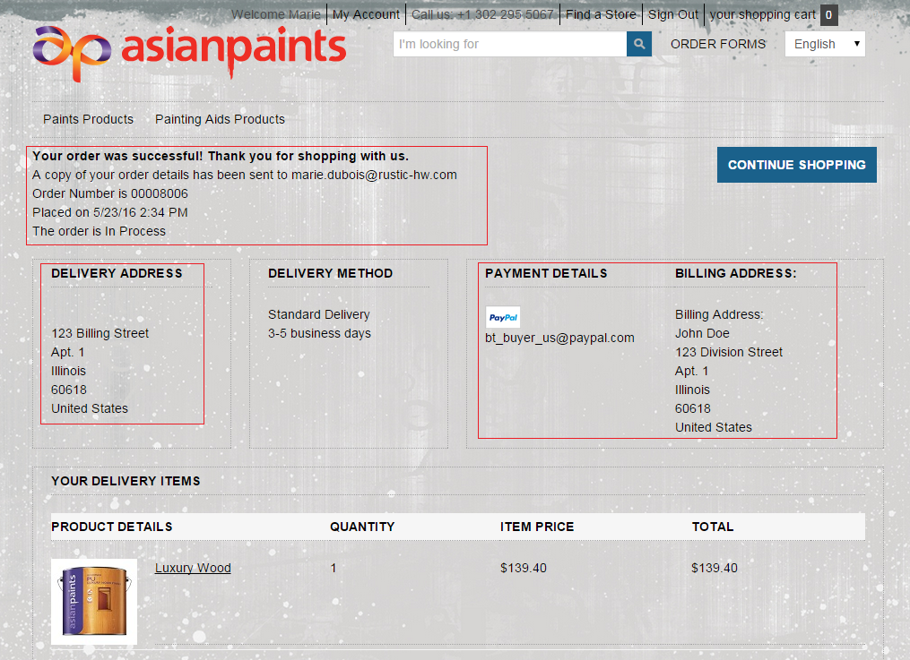
Order Confirmation Page on PayPal Express Checkout

Slide 75
PayPal Custom UI checkout along with other payment methods
Checkout with PayPal Custom UI is very similar to PayPal Express Checkout.
The Checkout with PayPal Custom UI integration is listed with other payment methods such as credit cards and the overall order experience is matched to what a consumer would go through with a credit card.
Therefore, if a consumer 'clicks' on the 'PayPal' payment method they are sent to PayPal to enter their credentials and finish checking out.
The final 'PayPal' screen would list a 'Pay' button with the consumer returning to the merchant and seeing an order confirmation page.
Customer enters shipping and billing addresses during Checkout process.

Slide 76
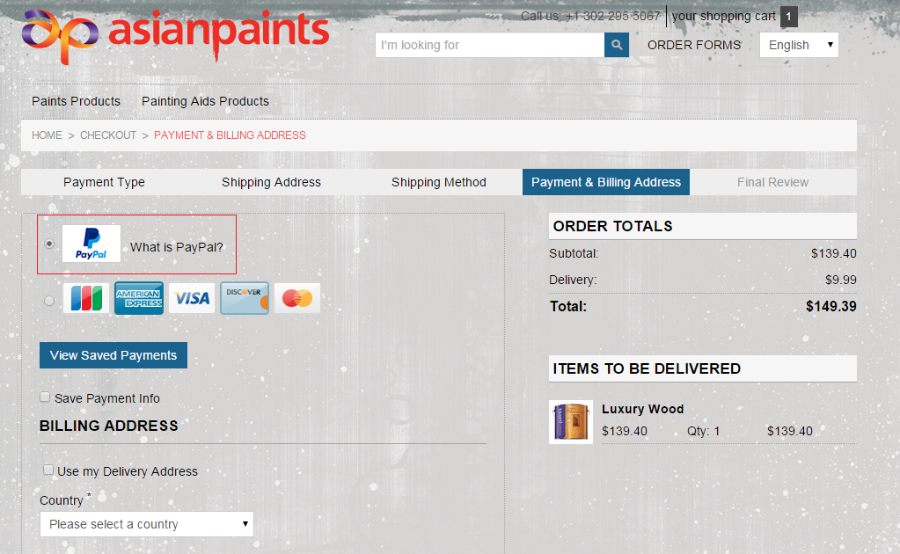
. Multi Checkout Page (Payment Details Step) with chosen PayPal option

Slide 77
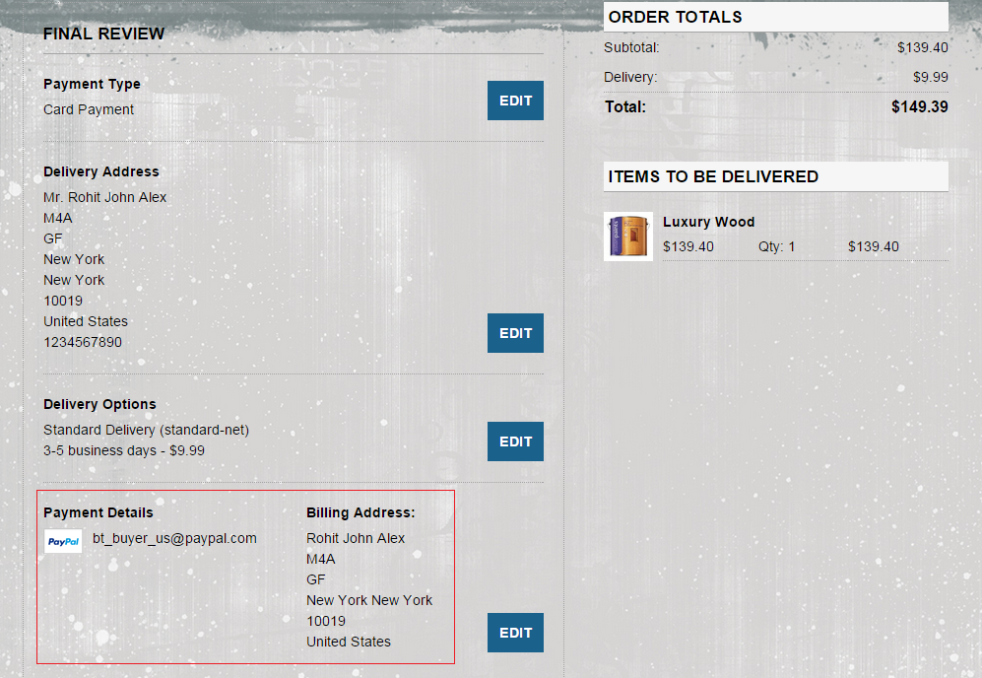
Final Review page on Custom PayPal Checkout

Slide 78
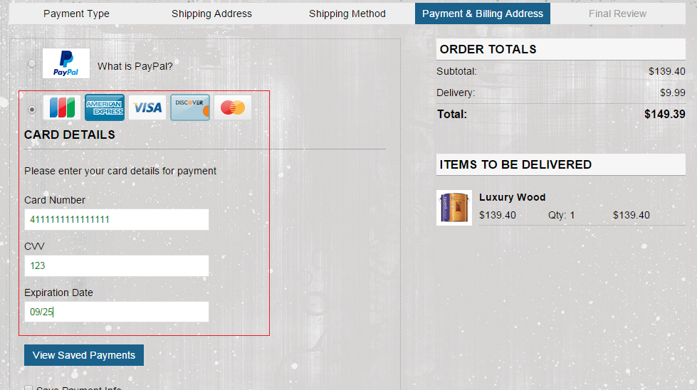
Multi Checkout Page (Payment Details Step) with chosen Credit Card option

Slide 79
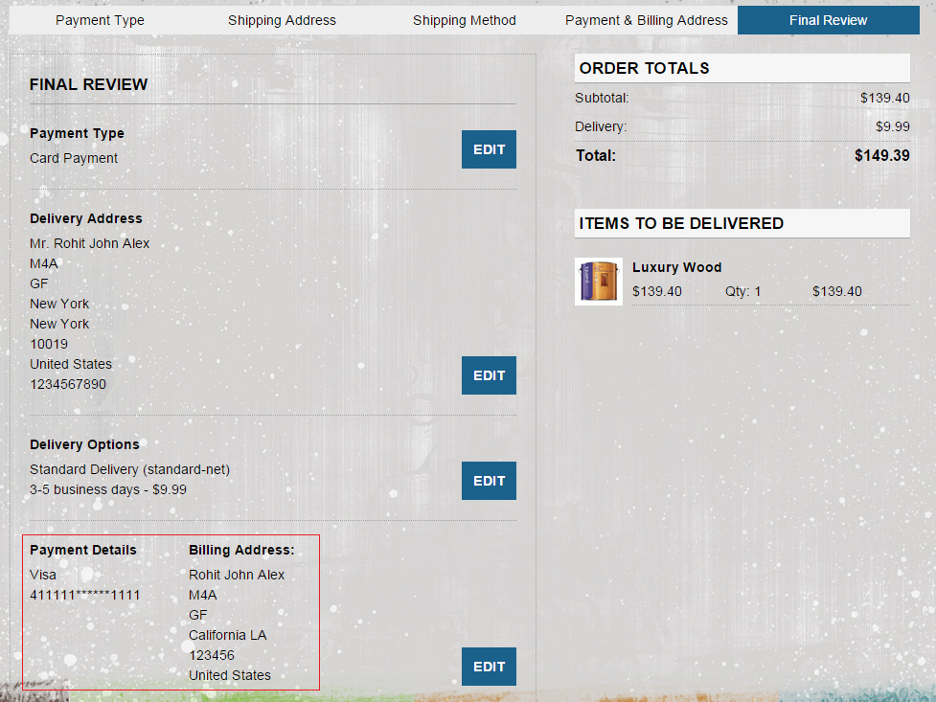
Final Review page on Credit Card Checkout

Slide 80
Replenishment orders for 5.7 B2B
The plugin provides the ability to pay orders scheduled on a regular basis using Braintree Credit Card payments or PayPal authorization via Braintree.

Slide 81
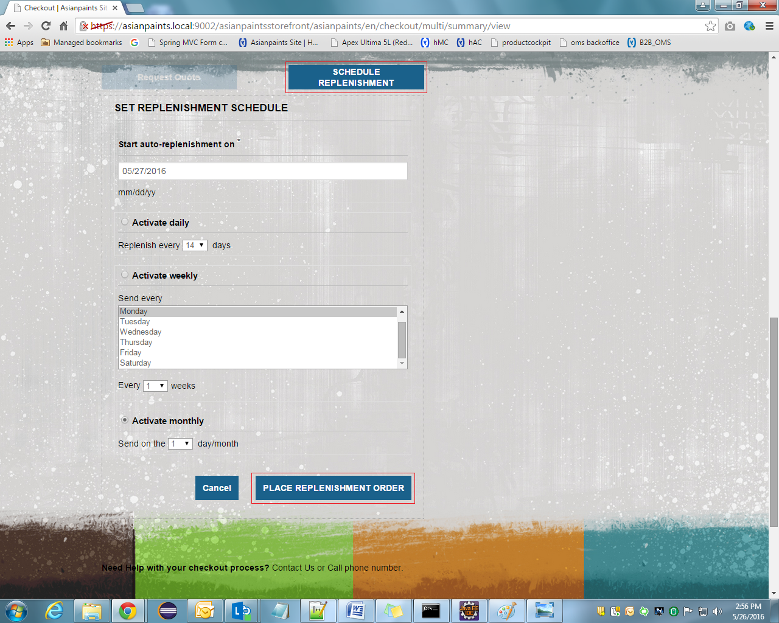
Final Review page on B2B 5.7

Slide 82
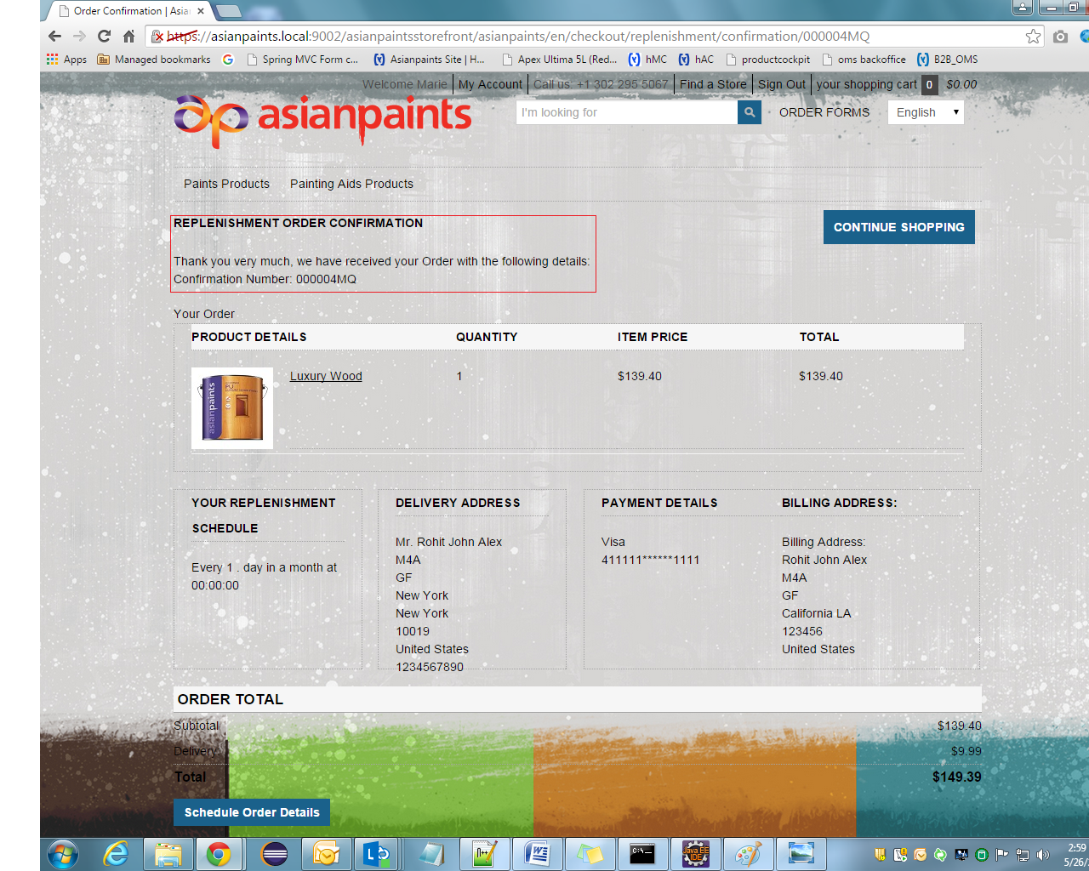
Replenishment Order Confirmation Page

Slide 83
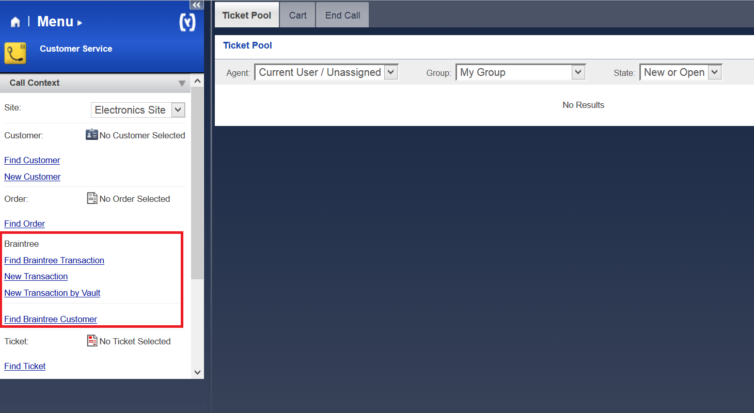
Back-office operations with Braintree Payments
Braintreecscockpit extension extends cscockpit by adding Braintree payment functionality.

Slide 84
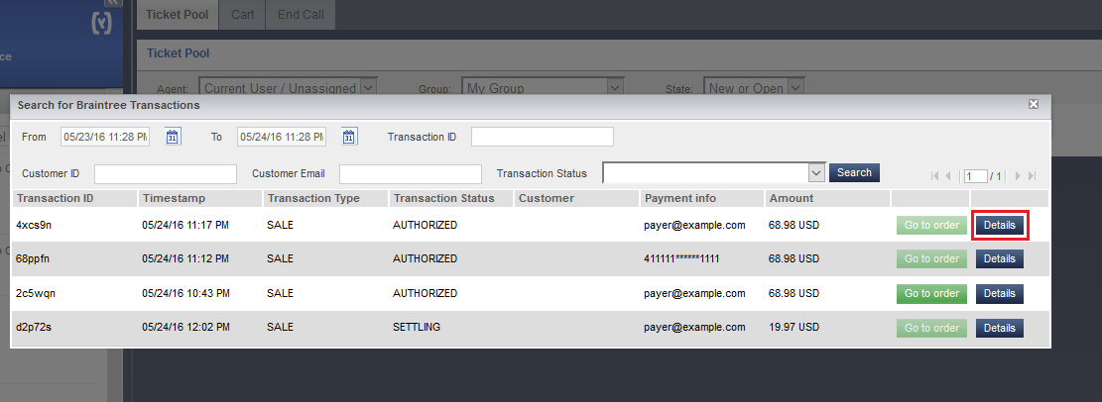
Find Braintree Transaction Section
The plugin provides the ability to search for a set of transactions based on specific filters
Search for Braintree Transactions Pop-up

Slide 85
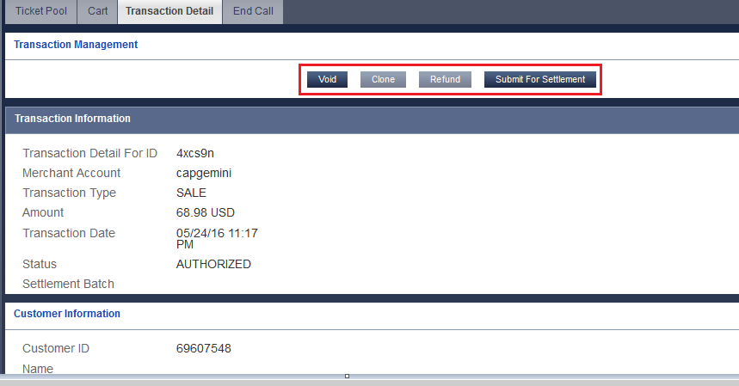
Braintree Transaction Details Tab
There is possibility to get details on a specific transaction or go to appropriate order.

Slide 86
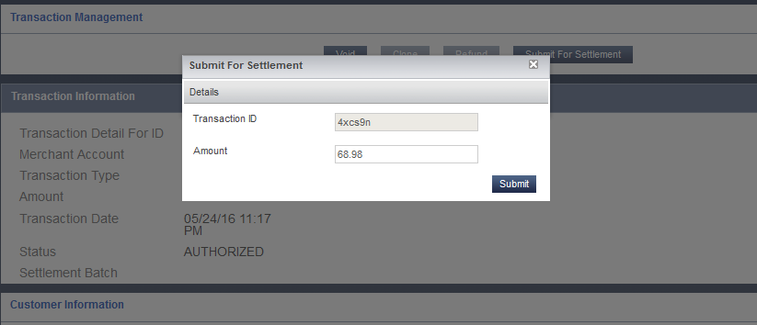
Submit for Settlement Braintree Transaction Pop-up
The plugin provides the ability to capture or settle an authorization later. The plugin sends a request to Braintree to 'submit for settlement'.

Slide 87
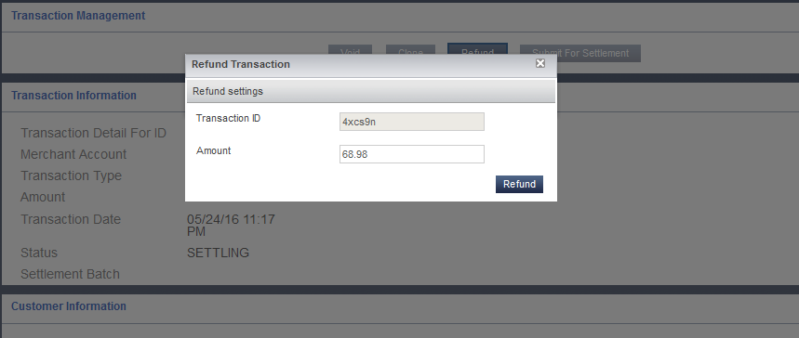
Refund Braintree Transaction Pop-up
The plugin provides the ability to clone a transaction. Cloning a transaction will create a new transaction by copying all the attributes, except amount, of the original transaction.

Slide 88
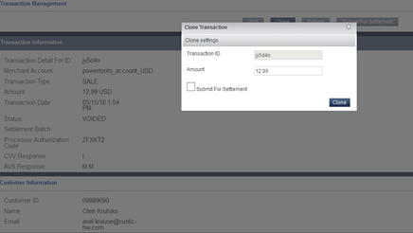
Clone Braintree Transaction Pop-up
The plugin provides the ability to clone a transaction. Cloning a transaction will create a new transaction by copying all the attributes, except amount, of the original transaction.

Slide 89
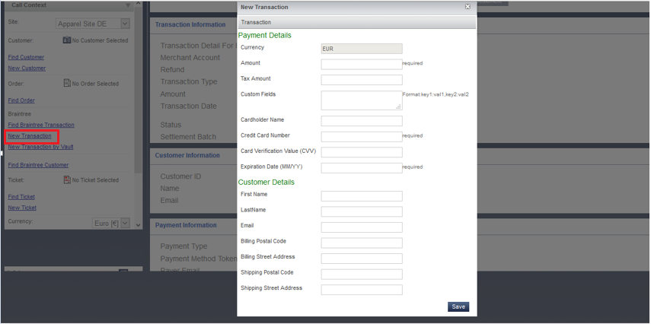
New Braintree Transaction Pop-up
In addition, plugin allows create new Braintree transactions by entering payment details or using payment method token

Slide 90
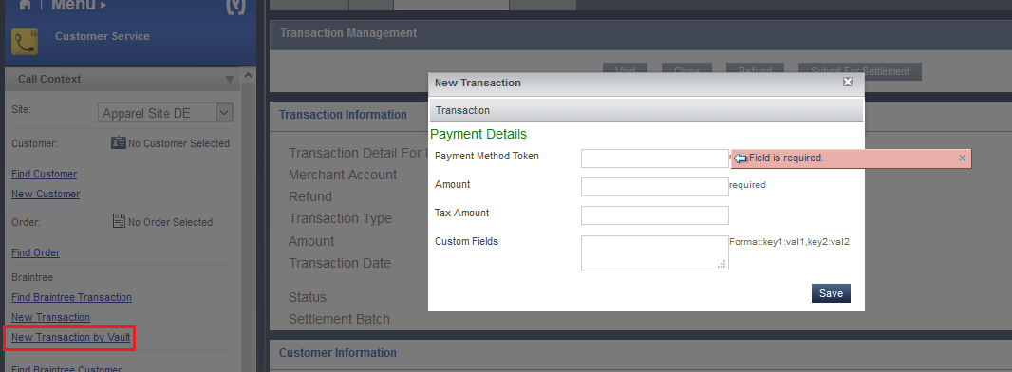
New Braintree Transaction by Vault Pop-up

Slide 91
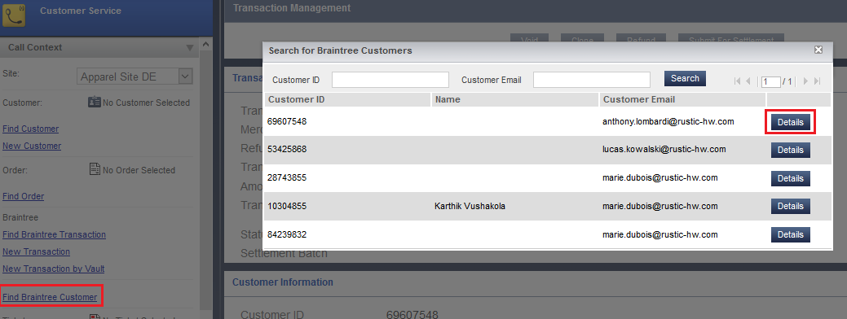
Search for Braintree Customers Pop-up
The plugin is able to get customer details from the Braintree merchant's vault by passing in a customer id or customer email.

Slide 92
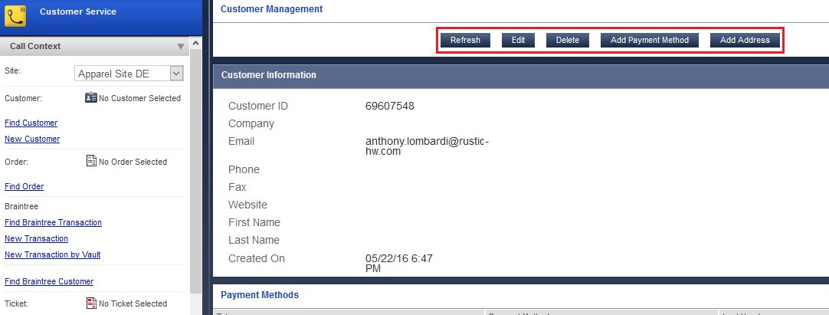
Braintree Customers Details Tab
The customer details will include any payment method tokens, addresses, phone numbers, email addresses and other details that are associated with a particular Braintree customer.

Slide 93
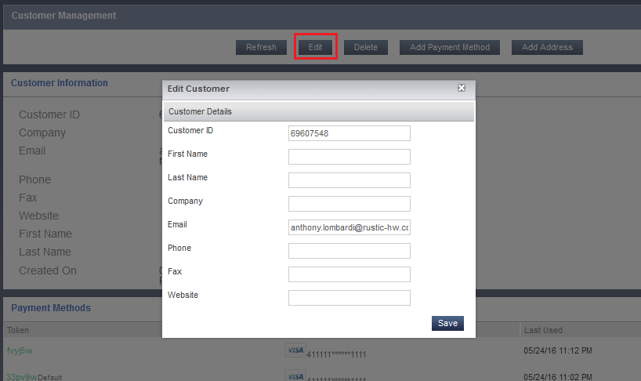
Braintree Customers Edit Pop-up
User can edit a customer's details using edit action button.

Slide 94
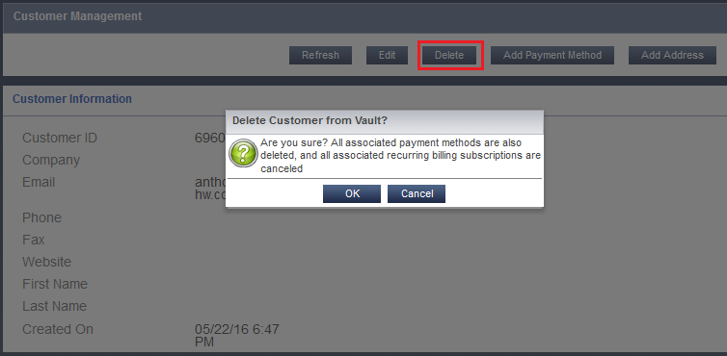
Delete Braintree Customer Pop-up
The plugin is able to delete a customer from the merchant's Braintree vault.

Slide 95
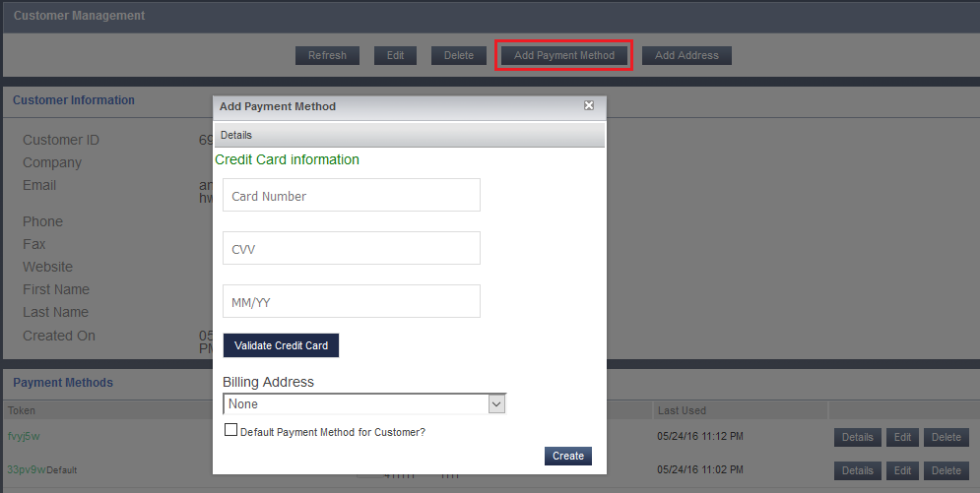
Add Braintree Payment Method Pop-up
The plugin is able to lookup, add, update, and delete a payment method to a Braintree customer.

Slide 96
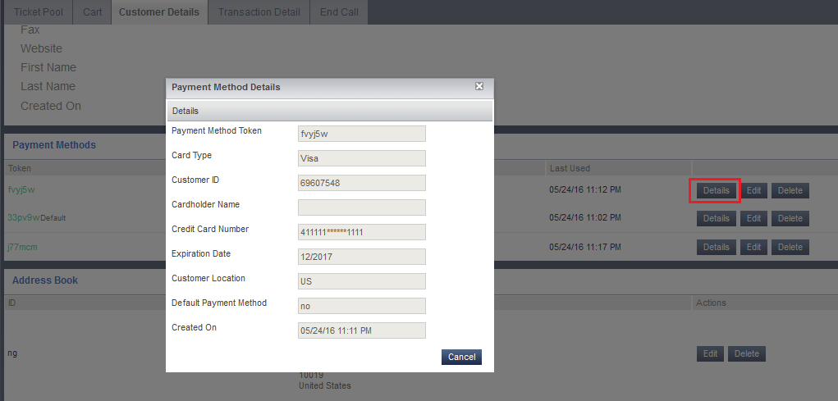
Braintree Payment Method Details Pop-up

Slide 97
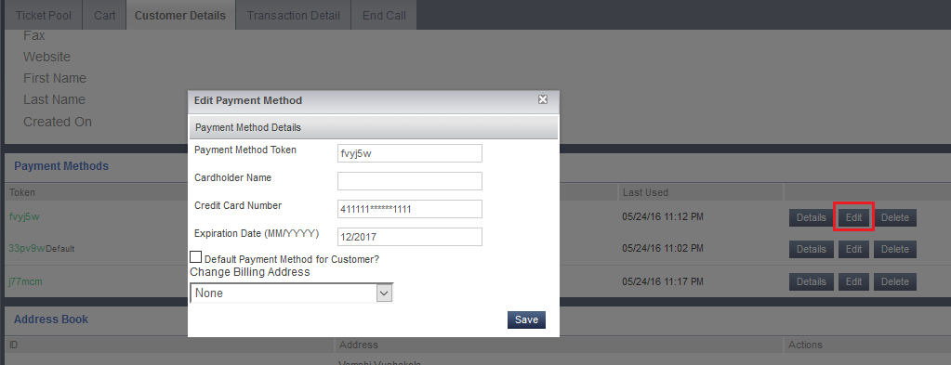
Edit Braintree Payment Method Pop-up

Slide 98
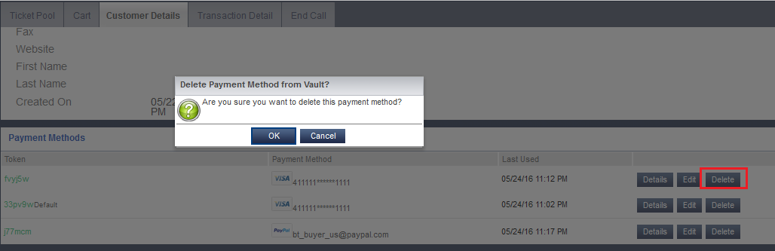
Delete Braintree Payment Method Pop-up

Slide 99
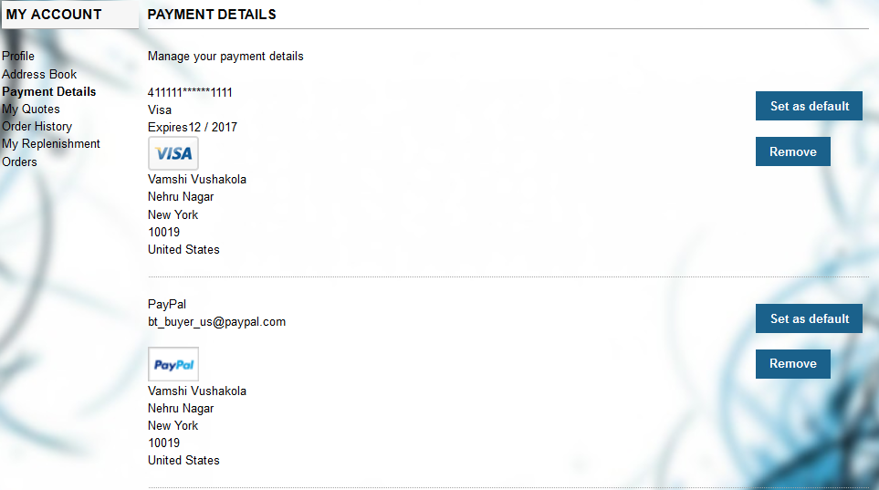
Accelerator storefront Account Payment Details
The plugin synchronizes Braintree payment methods with Payment Details belonging to customer account on Hybris Accelerator storefront

Slide 100
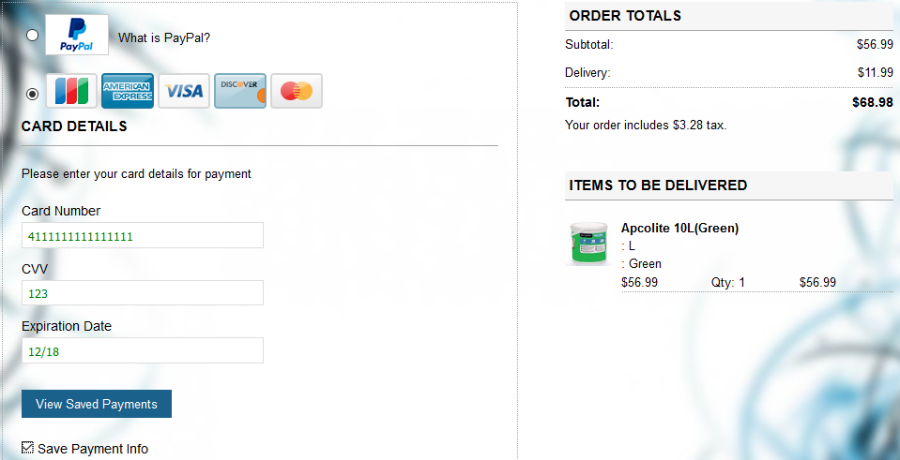
Chose ‘Save Payment Info’ option on Accelerator Checkout Flow
User can enter his credit card information (number, cvv, date) or use PayPal authorization and save this payment method by checking “Save payment Info” checkbox on Accelerator Checkout flow.
Next time he will be able to pay by choosing this previously stored payment method without entering his credit card details or doing PayPal authorization again.

Slide 101

Select Stored Payment Method

Slide 102

Add Braintree Customer Address Pop-up
The plugin is able to add, update, and delete Address Book of Braintree customer.

Slide 103

Edit Braintree Customer Address Pop-up

Slide 104

Delete Braintree Customer Address Pop-up

Slide 105

Accelerator storefront Account Address Book
The plugin synchronizes Braintree customer Address Book with Address Book belonging to customer account on hybris Accelerator storefront.

Slide 106

Braintree Credit Card Client Side Validation
Credit card payment information is verified by Braintree on the client side.

Slide 107
Thank You

